Slide 1
Cloud-Based File Storage System (Mini Google Drive)
By: S. Nakshatra
Using Google Cloud Platform

Slide 2
Project Goal
• Build a cloud-based file storage system similar to Google Drive
• Allow users to upload, download, and manage files securely
• Use Google Cloud for backend, storage, and deployment
• Provide a simple, clean, and user-friendly interface

Slide 3
Tools & Technologies
Frontend:
HTML, CSS, JavaScript
Backend:
Python Flask, JWT Authentication
Cloud Services:
Google Cloud Run (Backend Deployment)
Cloud Storage (File Storage)
Firestore (Metadata Database)
Cloud Build & Artifact Registry

Slide 4
System Architecture
User → Frontend (HTML/JS)
↓
Backend API (Flask on Cloud Run)
↓
Cloud Storage (Files)
↓
Firestore Database (Metadata)

Slide 5
Demo Screenshots
Signup Page
Login Page
Dashboard
Upload File
Storage Bucket
Metadata in FireStore
Backend

Slide 6
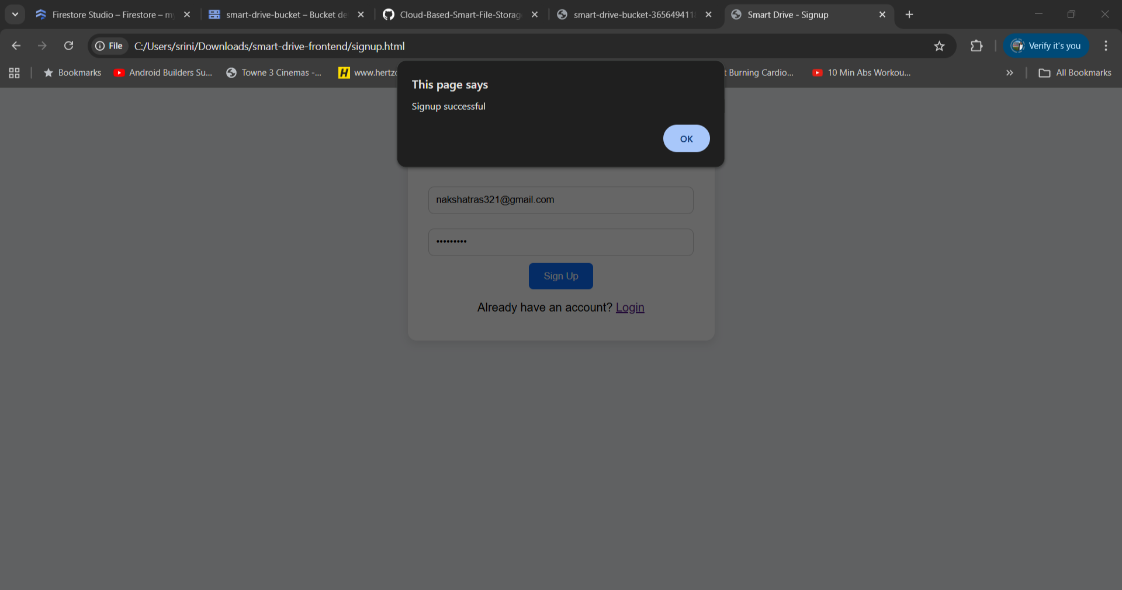
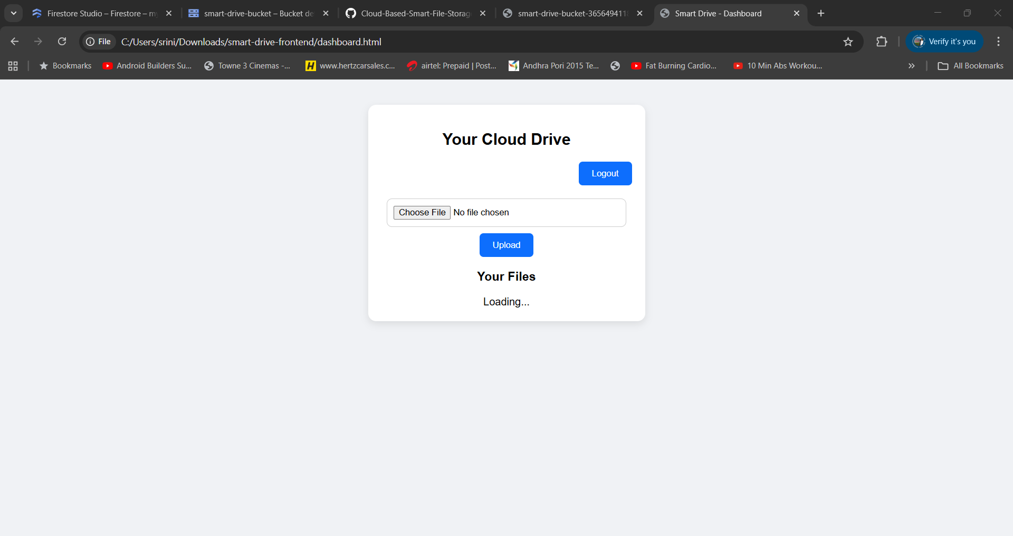
Sign Up & Login

Slide 7
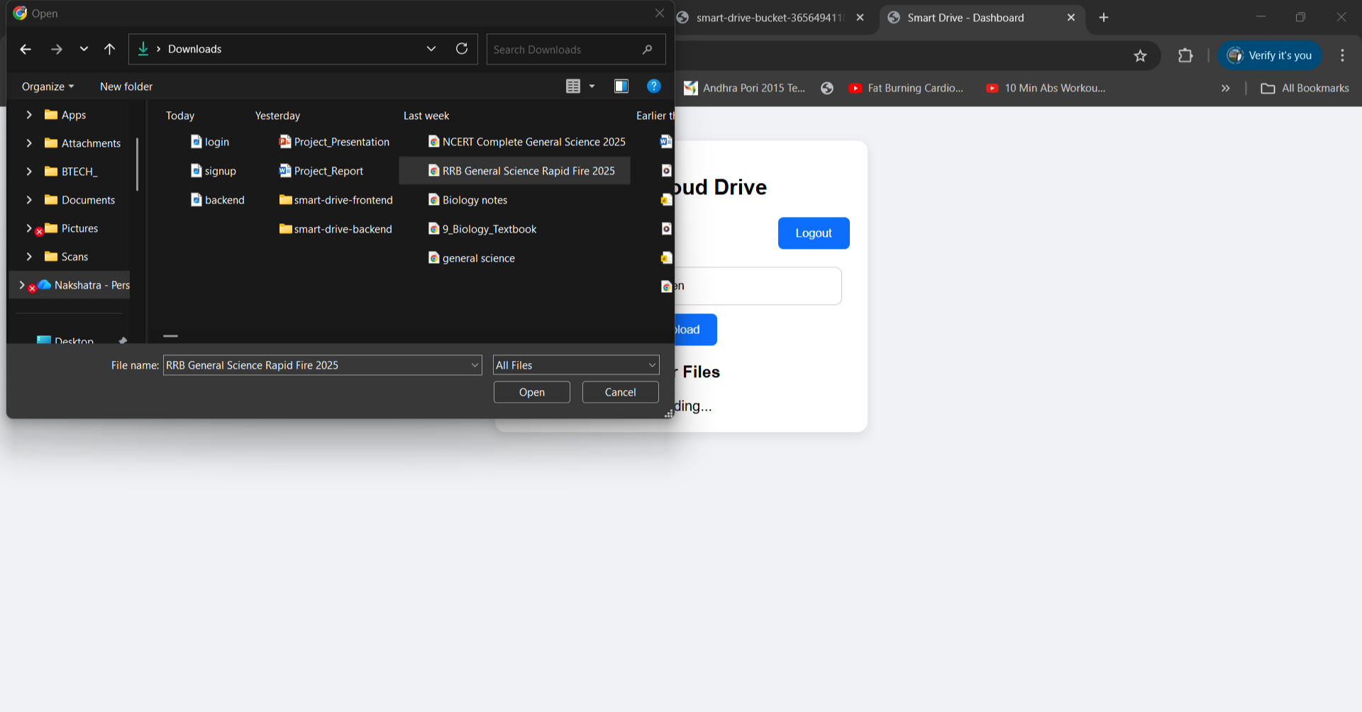
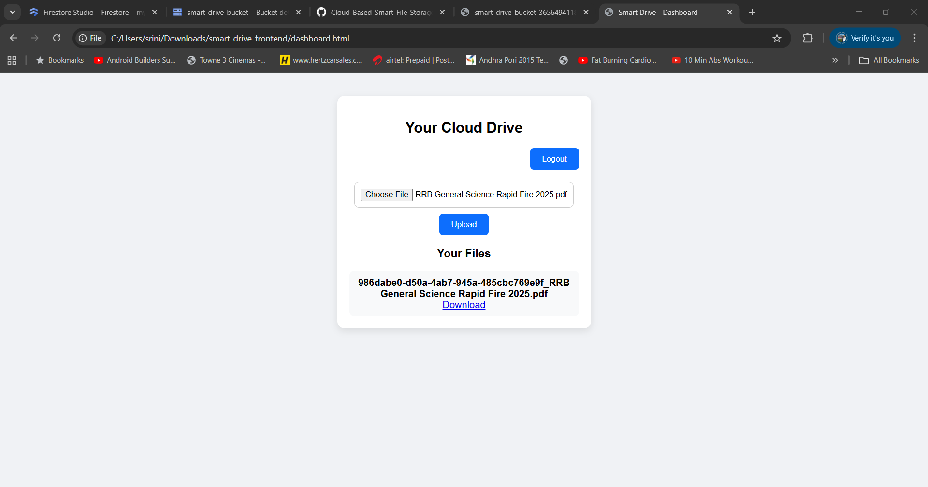
Uploading Files

Slide 8
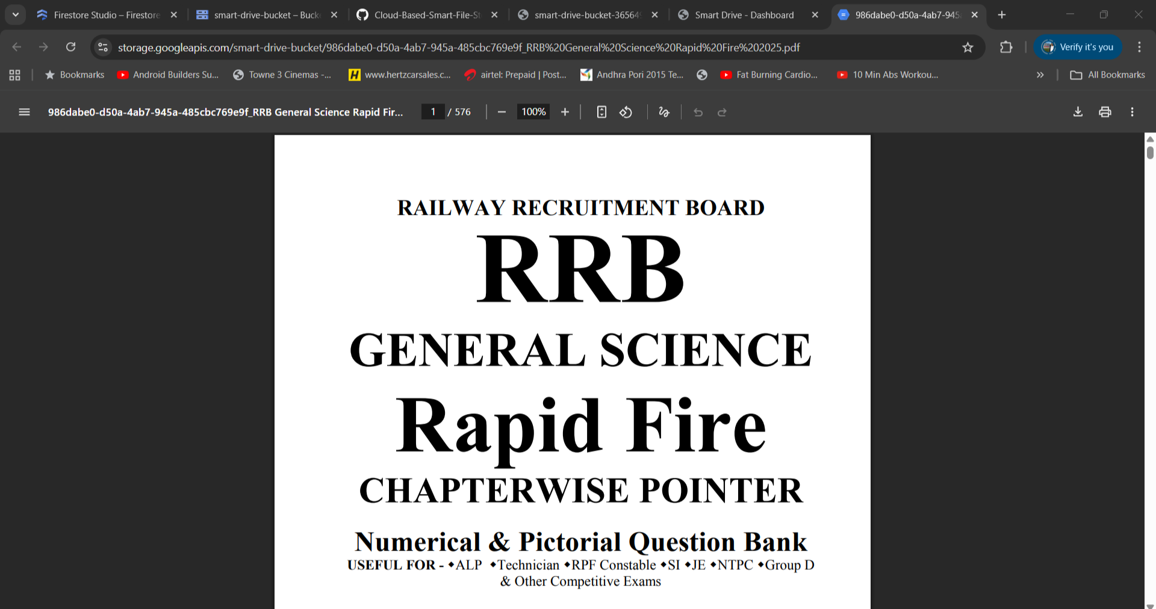
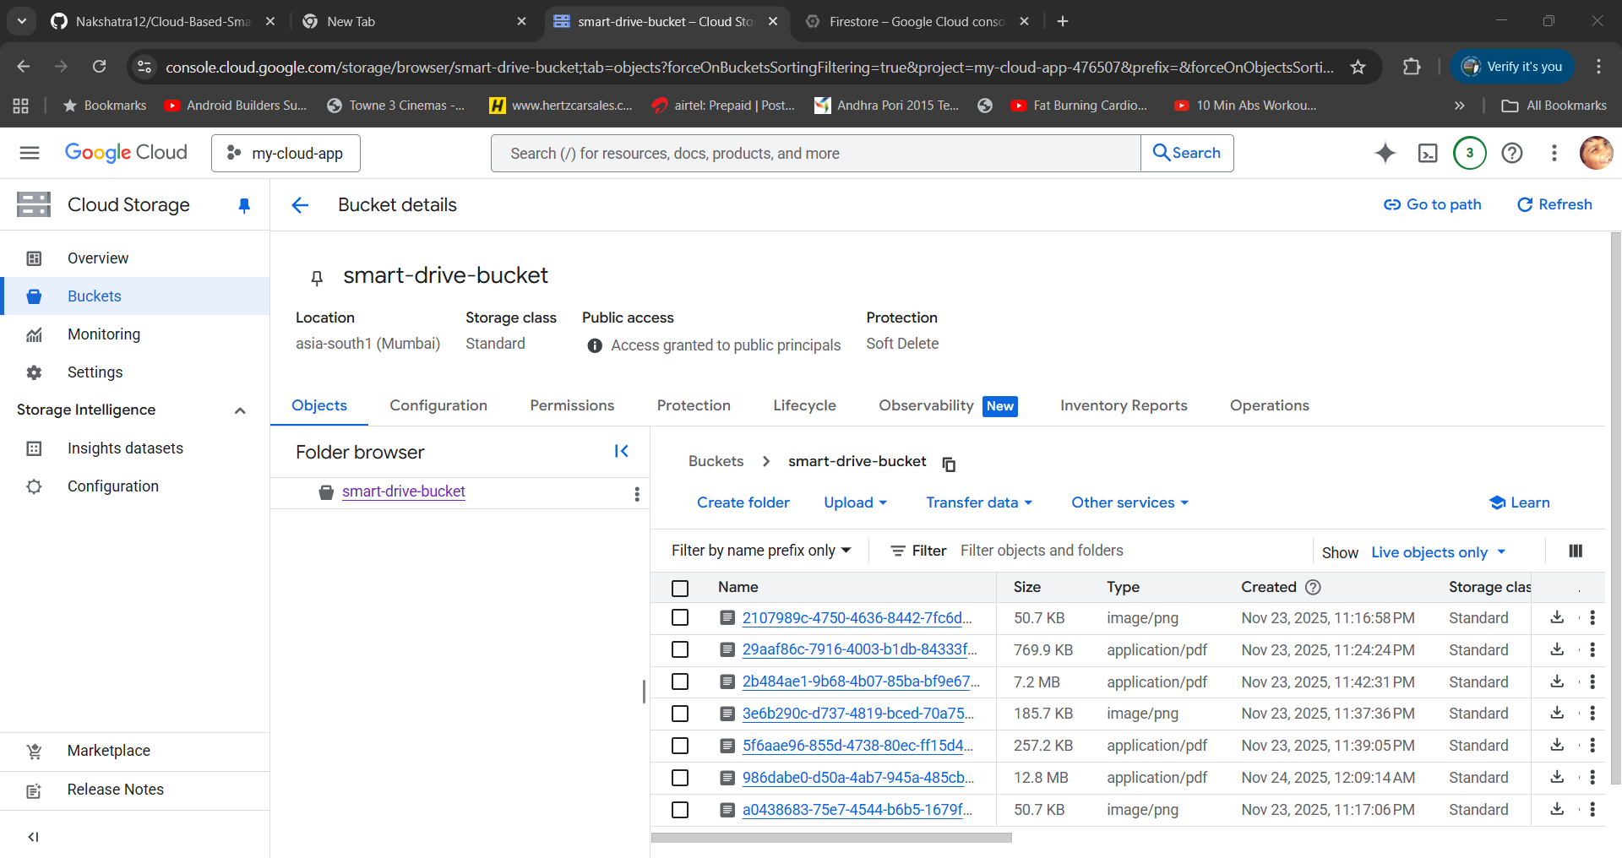
Download-Sharable Link & Storage Bucket

Slide 9
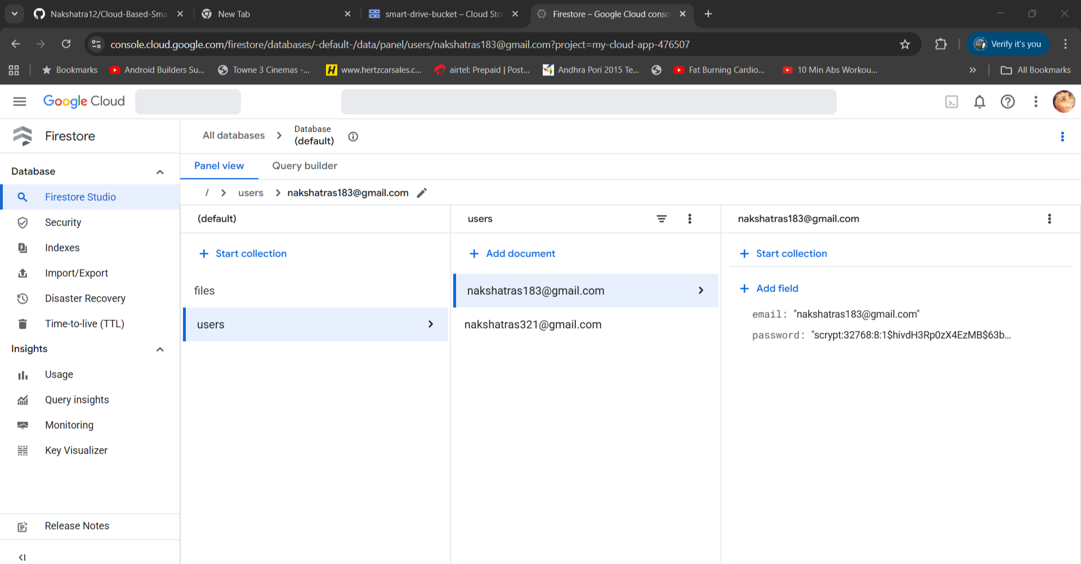
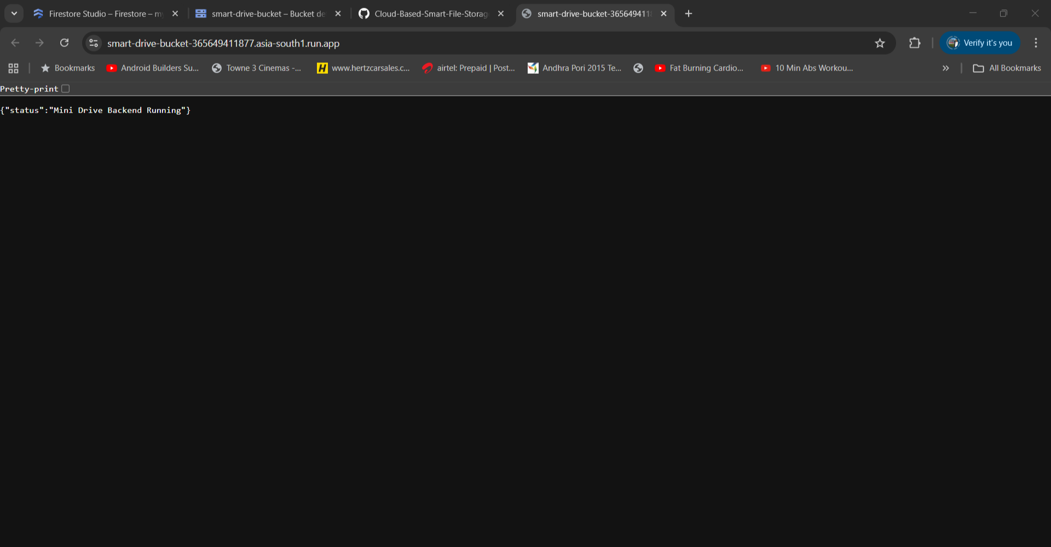
Metadata in FireStore & Backend

Slide 10
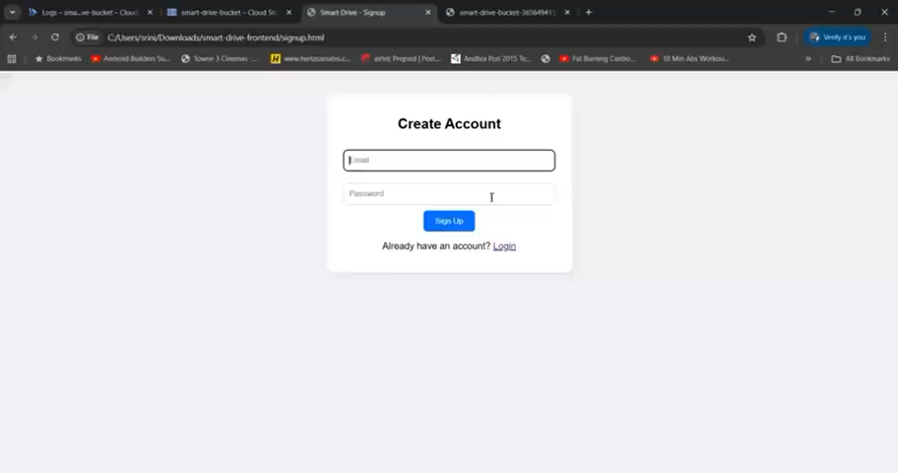
Demo Video

Slide 11
Conclusion
Fully functional cloud-based storage system
Built using GCP serverless architecture
Supports authentication, upload, listing, and download
Scalable, secure, and easy to enhance further

